Slide 1

Intro To Visual Studio Code
By Kevin Israel
“Chance favors only the prepared mind.”
- Louis Pasteur

Slide 2

Intro To Visual Studio Code
Agenda
Downloading .NET Core
Downloading Visual Studio Code
Getting Started With Visual Studio Code
Folder Based
Intellisense
Source Control
Debugging
CLI for project initialization
Linting
Code Navigation
Code Compiling
Extensions
Refactoring
Configurable

Slide 3
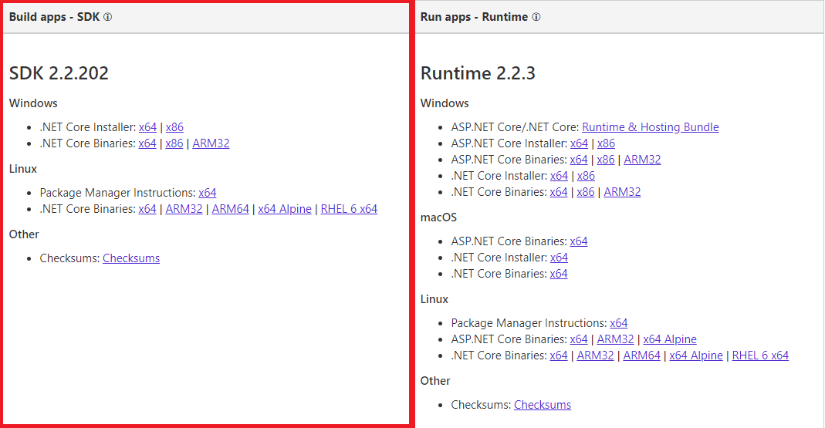
Getting Started – Downloading .NET Core
https://dotnet.microsoft.com/download/dotnet-core/2.2

Slide 4
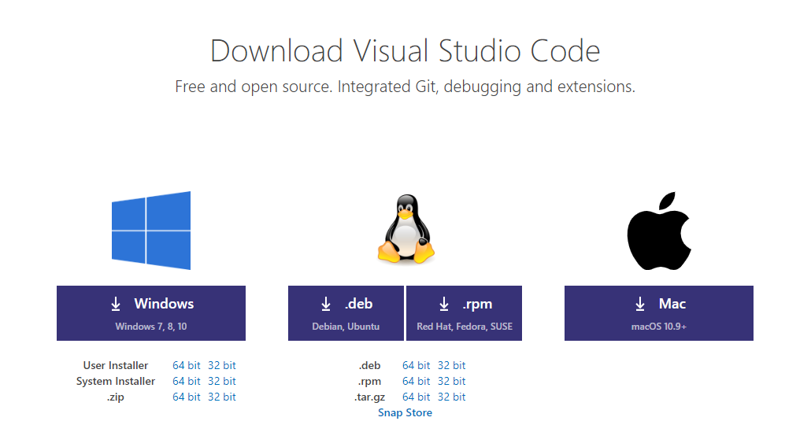
Getting Started – Downloading Visual Studio Code
https://code.visualstudio.com/download

Slide 5
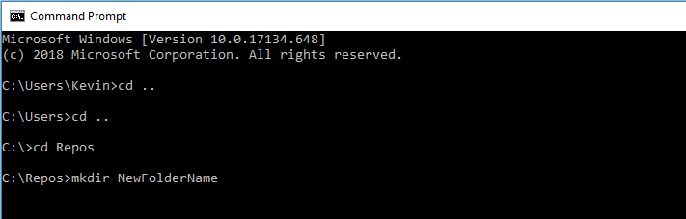
Getting Started With Visual Studio Code
Step 1 – Create a folder using your computers GUI
or
Step 1 – Create a folder using CLI => example:

Slide 6
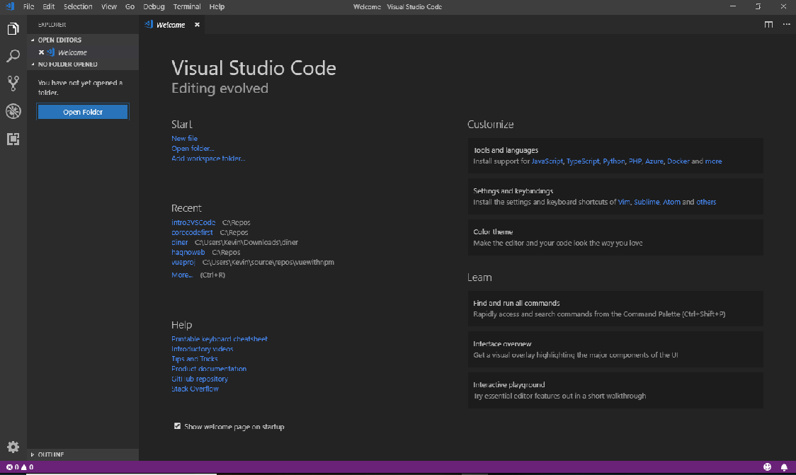
Getting Started With Visual Studio Code

Slide 7
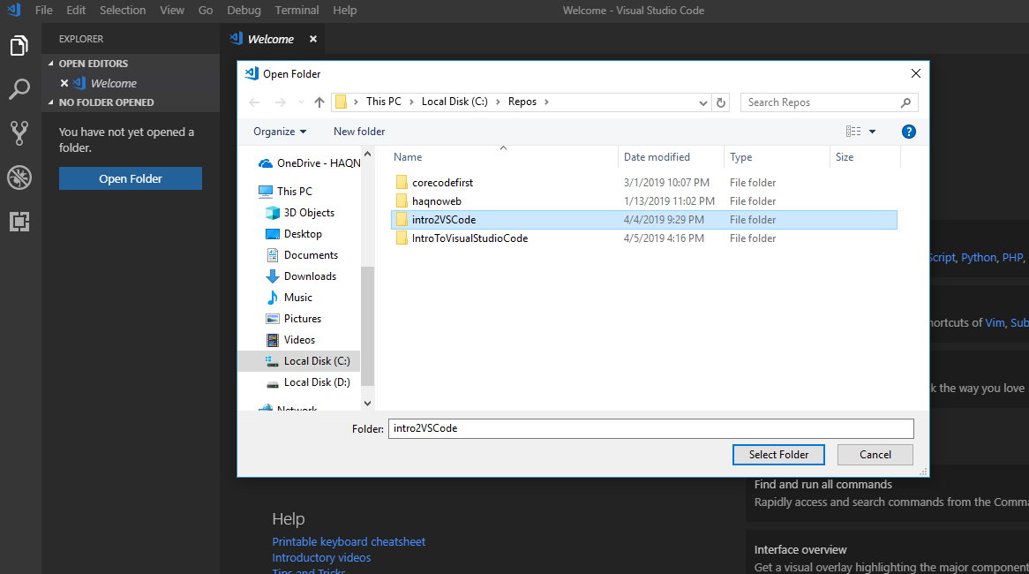
Getting Started With Visual Studio Code

Slide 8
Getting Started With Visual Studio Code

Slide 9
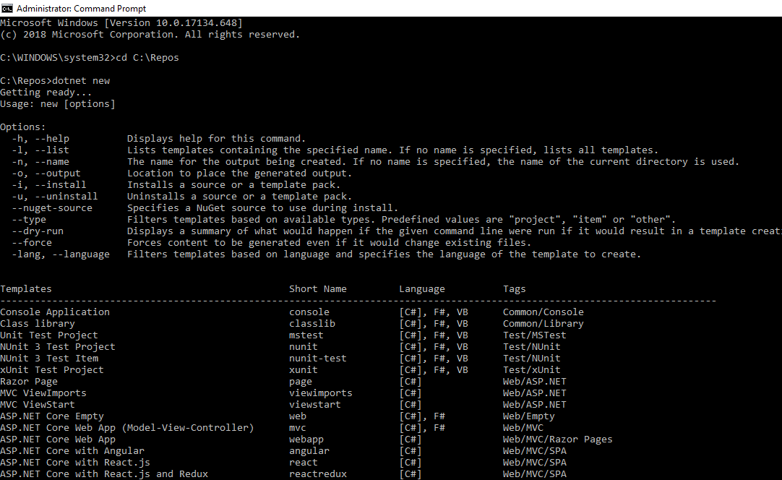
Getting Started With Visual Studio Code

Slide 10
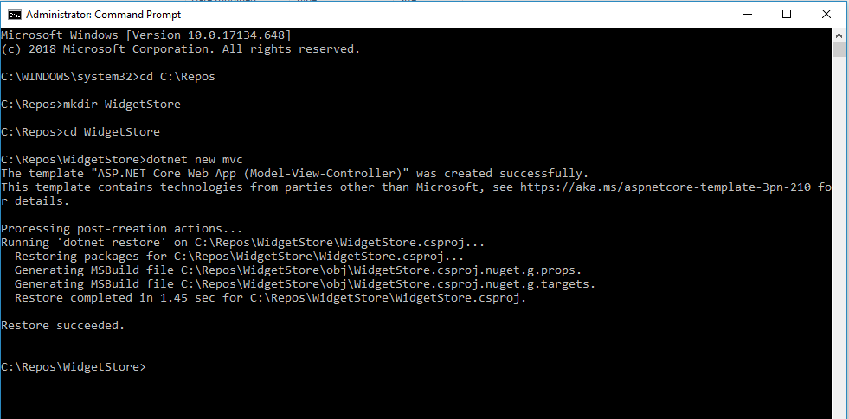
Getting Started With Visual Studio Code

Slide 11
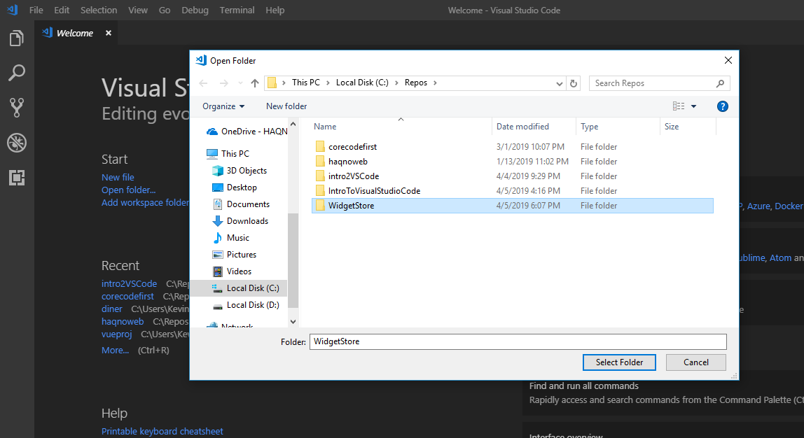
Getting Started With Visual Studio Code

Slide 12
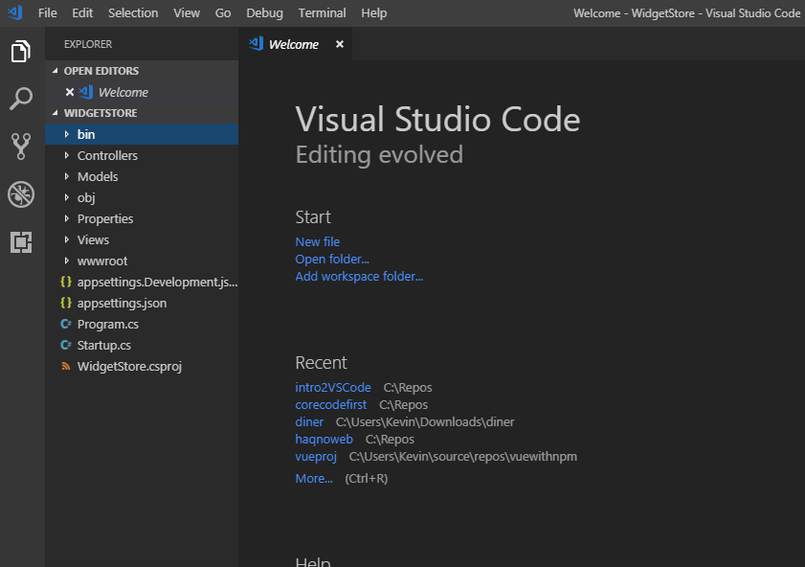
Getting Started With Visual Studio Code

Slide 13
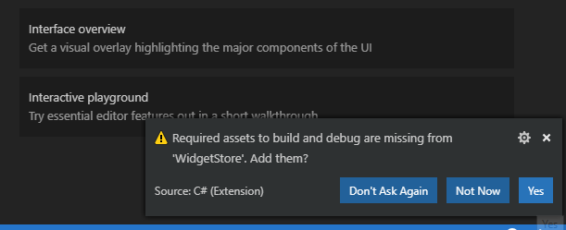
Getting Started With Visual Studio Code

Slide 14
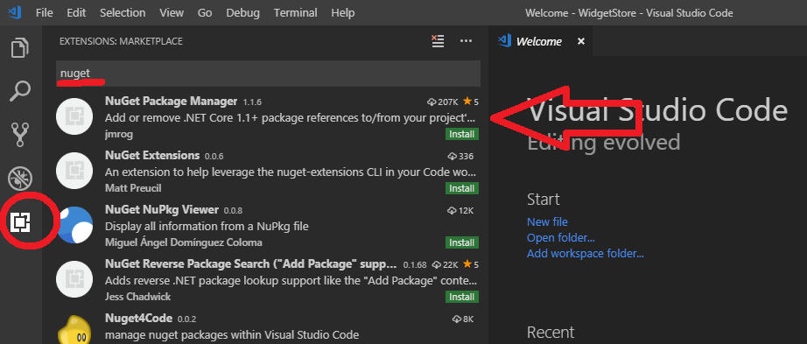
Getting Started With Visual Studio Code

Slide 15
Getting Started With Visual Studio Code

